Slide 1
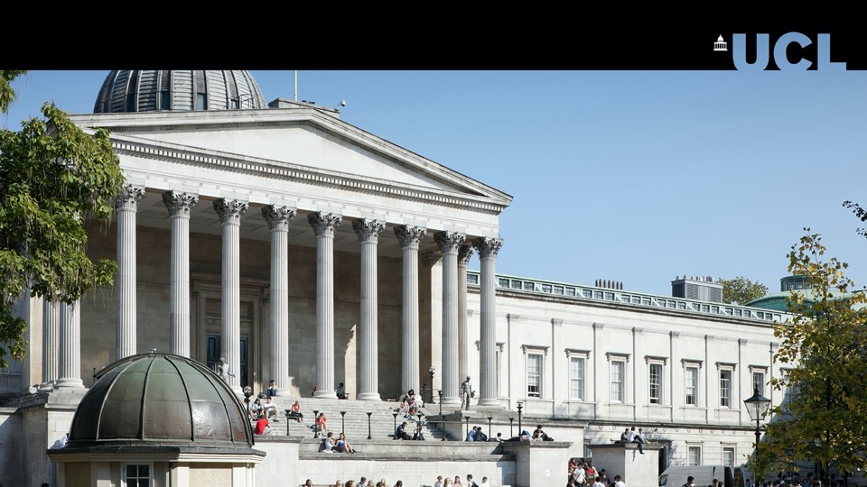
Department of Geography
GEOG0125: Advanced Topics in Social and Geographic Data Science
Notes:
Hello everybody, and welcome to UCL.
My name is Anwar Musah. I am a Lecturer in Social and Geographic Data Science within the Department of Geography.
I’m your module convenor for the “Advanced Topics in Social and Geographic Data Science” which is a term 2 module co-taught jointly by me, Dr Stephen Law, who is also a Lecturer in Geography Department.
… and the purpose of this video is to give you an overview of this course and introduction to what its all about, and some of the interesting topics we’ll be teaching, as well as the kind of skills you will acquire - which quite frankly are in high demand. So, let’s begin…

Slide 2
Department of Geography
Aims of Module
The following learning outcomes:
To introduce you to advanced quantitative methodology through the following: 1.) Bayesian Statistics (7 weeks) and 2.) Machine Learning (3 weeks).
From the Bayesian side, you will be introduced to probability theory for Bayesian inference. How to apply the various families of multivariable regression models within a Bayesian framework for carrying out risk assessments in making spatial (& non-spatial) predictions and studying the associations between social-risk factors and outcomes
From the Machine Learning side, you will be introduced to the application of various types of computer vision and machine learning techniques for image processing and classification
With the increase in use of AI, these Bayesian and ML techniques are highly applicable for tackling challenges.
You will know how to carry out data analysis in software packages such as Stan with R/RStudio, and Pytorch that’s interfaced with Python.
Computer Science
Social and Geographic Data Science
Statistics
Geography and Social Science
Notes:
This module introduces state-of-the-art topics from two areas: 1.) Bayesian inference and 2.) Machine Learning methodologies. It’s designed to equip you will the knowledge in advanced statistical
and spatial analytical methodologies for future research challenge that are in the domains of social sciences and geography, and applicable to other areas such public health, criminology and disaster science etc.
This module provides a detailed introduction to Bayesian statistics using Stan and RStudio for statistical modelling and Bayesian computation. We will introduce you to the absolute basics of Bayesian theory as well as writing your own probabilistic codes in RStudio and Stan for carrying out a broad range of multivariable models within the Bayesian framework.
We will also introduce you to advanced machine learning methodologies which have significant applications in image classification and pattern recognition within the social sciences and geography. You will be taught Deep Learning, Convolutional Neural Networks (CNNs) and GeoAI using Pytorch in Python.
…so think of this as an interdisciplinary subject which brings together statistics, computer vision, GIS and evidence-based research for addressing social geographical problems, and for determining quantitatively the relationships (or interactions) that exists between human societies and space.
The structure of this module is as follows:

Slide 3




Department of Geography
Module Content
1.) Introduction to Bayesian Inference & Stan for Multivariable Models (Dr Anwar Musah)
Week 1: Introduction to Bayesian Statistics Week 2: Bayesian Generalised Linear Modelling (GLMs) Week 3: Bayesian Generalised Additive Modelling (GAMs)
2.) Introduction to Image Classification using Pytorch (Dr Stephen Law) Week 4: Introduction to Deep Learning in Python (DL) Week 5: Introduction to Convolutional Neural Networks in Python (CNN) Week 6: GeoAI
3.) Spatial Bayesian Risk Modelling (Dr Anwar Musah) Week 7: Hierarchical Regression Models Week 8: Spatial Intrinsic Conditional Autoregressive Regressive (ICARs) Models for Areal data Week 9: Bayesian Updating for Spatiotemporal Analysis for Areal data
4.) Wrap-up: Research Methodology Week 10: Study Design and Revision
*The concepts from term 1’s GEOG0114 Principles of Spatial Analysis and GEOG0115 Introduction to Social Data Science will be carried over into GEOG0125 Advanced
topics in Social Geographic Data Science
Notes:
You have 6 weeks for Bayesian content which is taught by me; and 3 weeks of machine learning content taught by Dr Stephen Law.

Slide 4
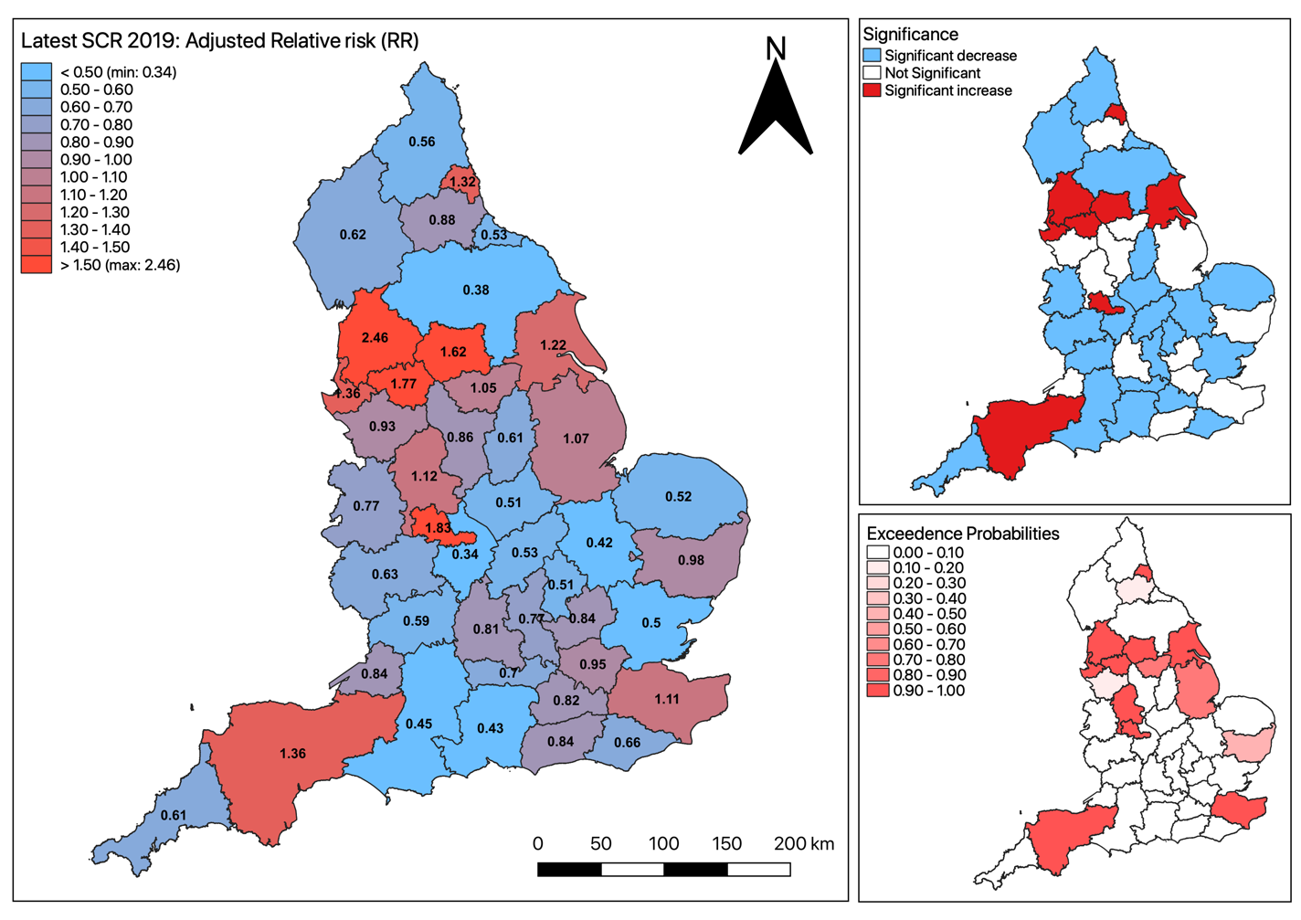
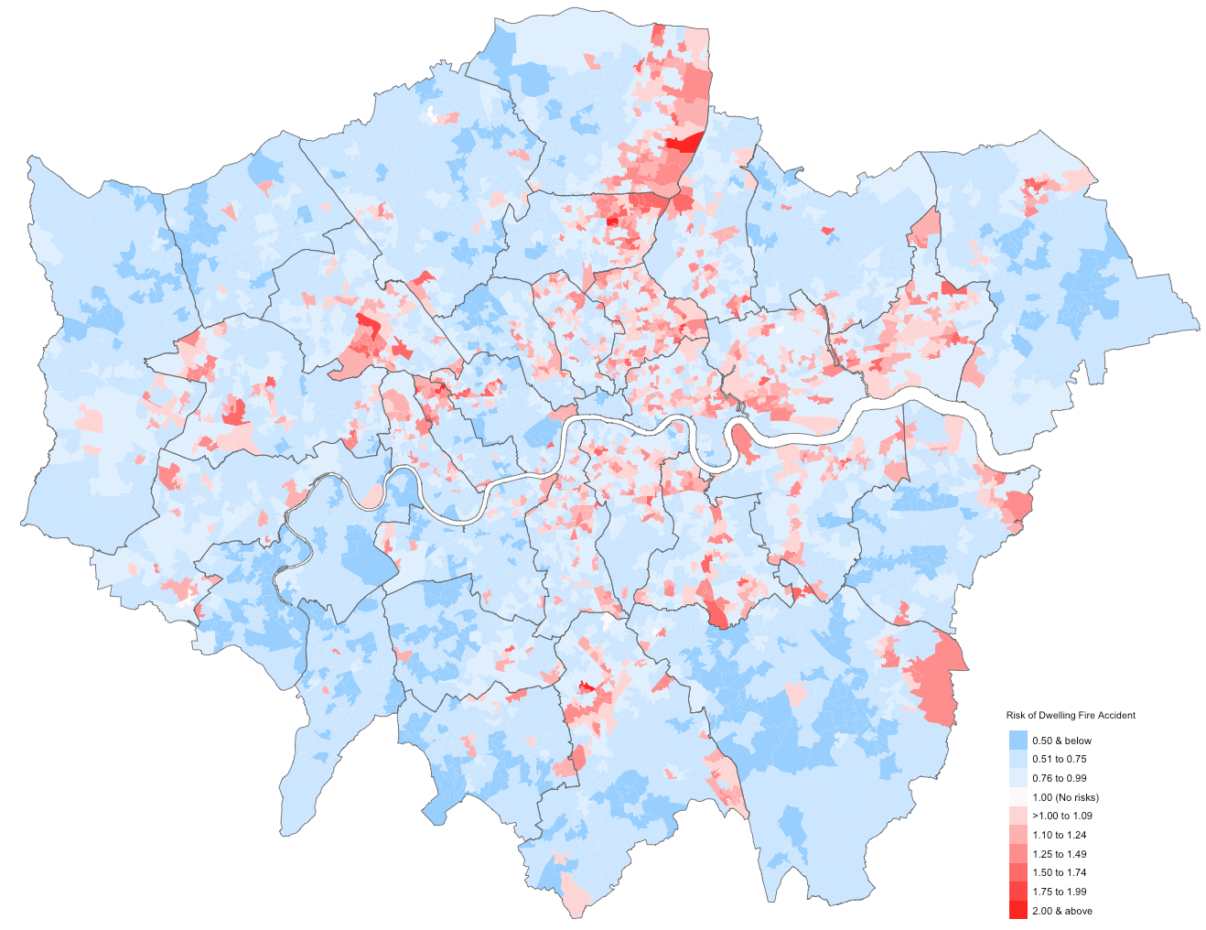
Department of Geography
Example 1: Bayesian inference for spatial mapping for risk assessments
Department of Geography
Li, L., Musah, A., Thomas M.G., Kostkova, P., (2021). An ecological study exploring the geospatial associations between socioeconomic deprivation and fire-related casualties in England (2010-2019) [Applied Geography Journal (see: https://doi.org/10.1016/j.apgeog.2022.102718)]
Notes:
Just to give you an example – at the end of the module – you should be in the position to apply Bayesian spatial spatiotemporal models for performing risk assessments for certain phenomena – in this context, we examined spatially the impact of socioeconomic deprivation across Fire Service Areas in England to examine how it is associated with increased risk of fire-related casualties and deaths in residential dwellings settings. You will be quantifying things like relative risks, 95% Credibility intervals as well as exceedance probabilities for describing risk of an outcome.

Slide 5

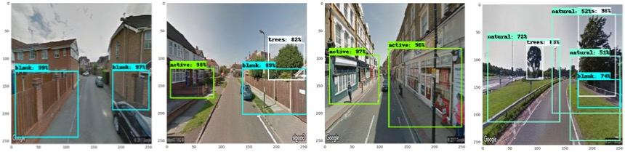
Department of Geography
Example 2: Machine learning for image classification and pattern recognition
Department of Geography
Convolutional Neural Networks (CNNs)
Blank Frontages
Single-Active Frontages
Both-Active Frontages
Non-Urban Frontages
Law, S., Shen, Y. and Seresinhe, C., (2017). An Application of Convolutional Neural Network in Street Image Classification: The Case Study of London. [ACM DL (see: https://doi.org/10.1145/3149808.3149810)]
Notes:
To give you another example from a Machine Learning perspective, at the end of the module will also be in the position to apply convolutional neural network which is a computer vision model for image classification in the geographical domain to learn and gain new knowledge to make predictions. You will learn how to build, train, test and validate ML models’ ability for recognizing certain features in image samples – for land-use, or these frontages can serve as environmental deterrents for residential burglary. Beyond the social content, these technique can be used to identify certain weather patterns that are early signs tor queues that a natural disasters.

Slide 6
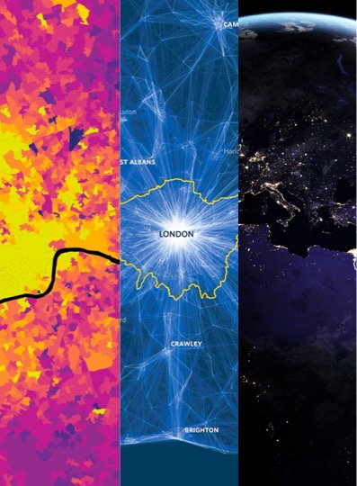
GEOG0125: Advanced Topics in Social and Geographic Data Science
a.musah@ucl.ac.uk
Notes:
So, I hope this video is a useful introduction.
For any questions or more information, or you can email me at
a.musah@ucl.ac.uk;
Thanks, and I look forward to meeting you!

